Slide 1

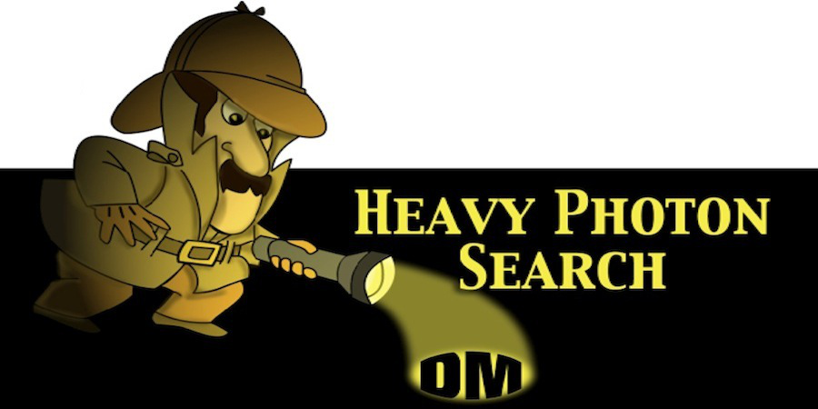

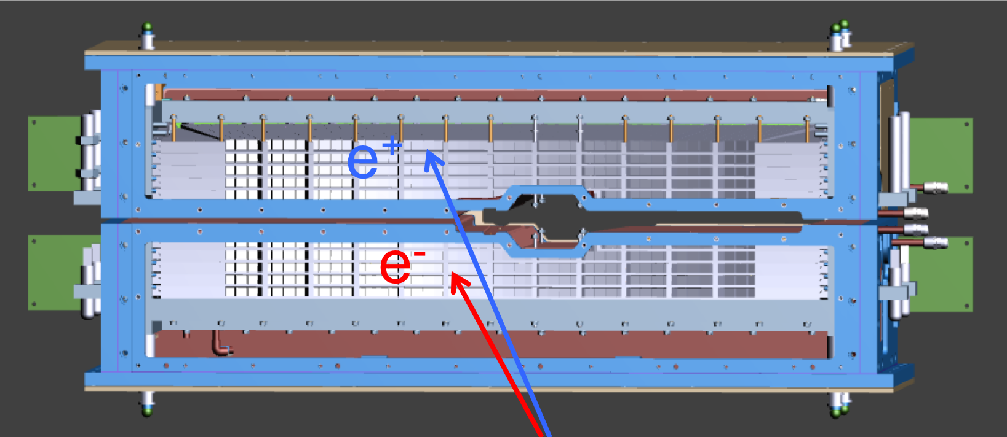
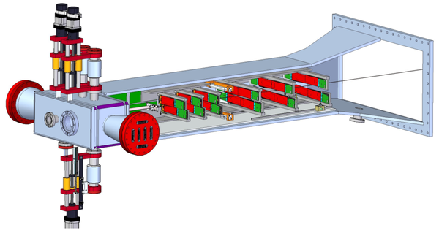
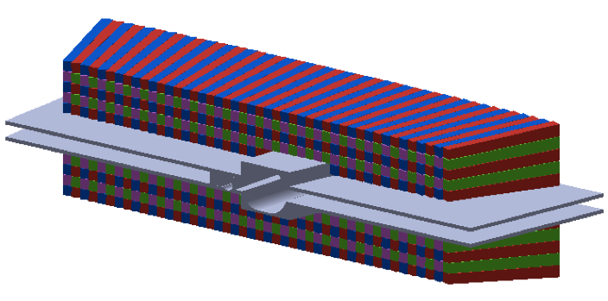
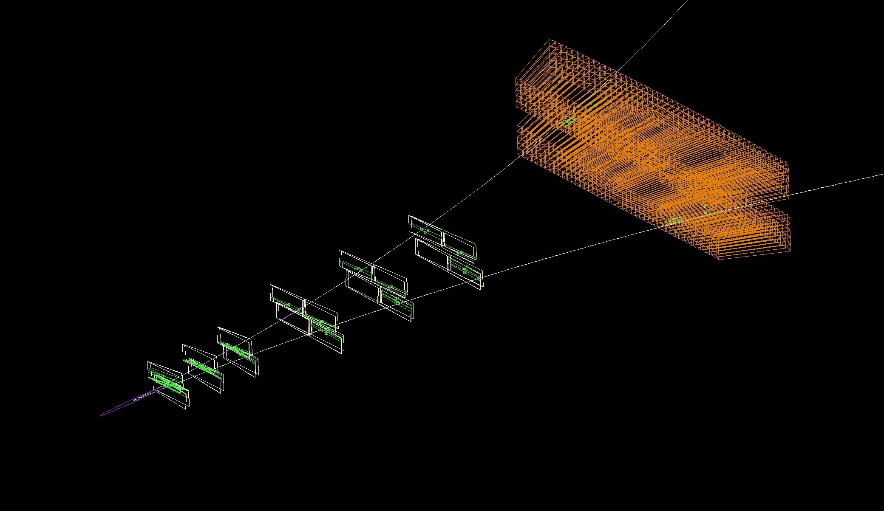
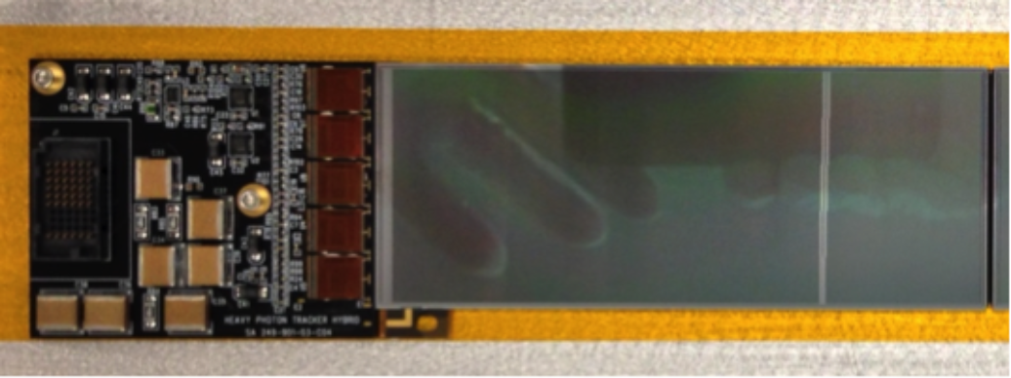
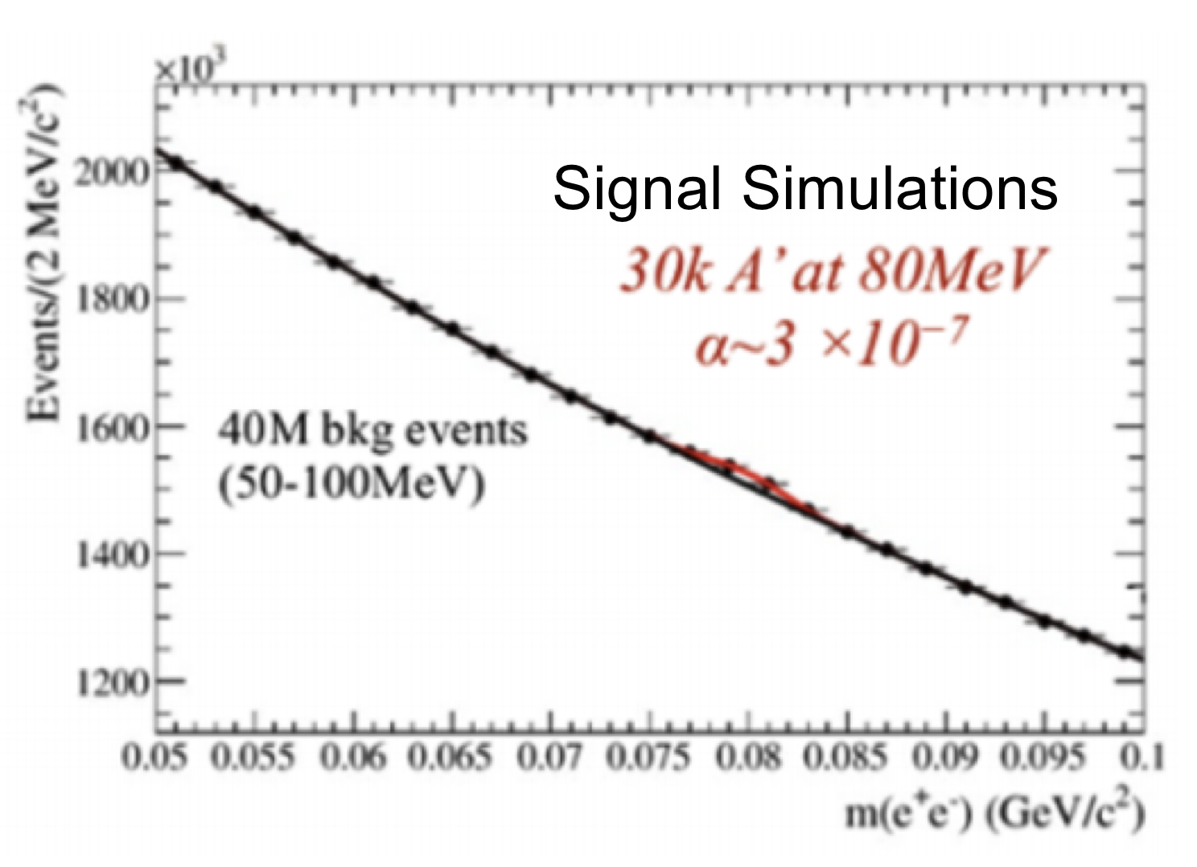
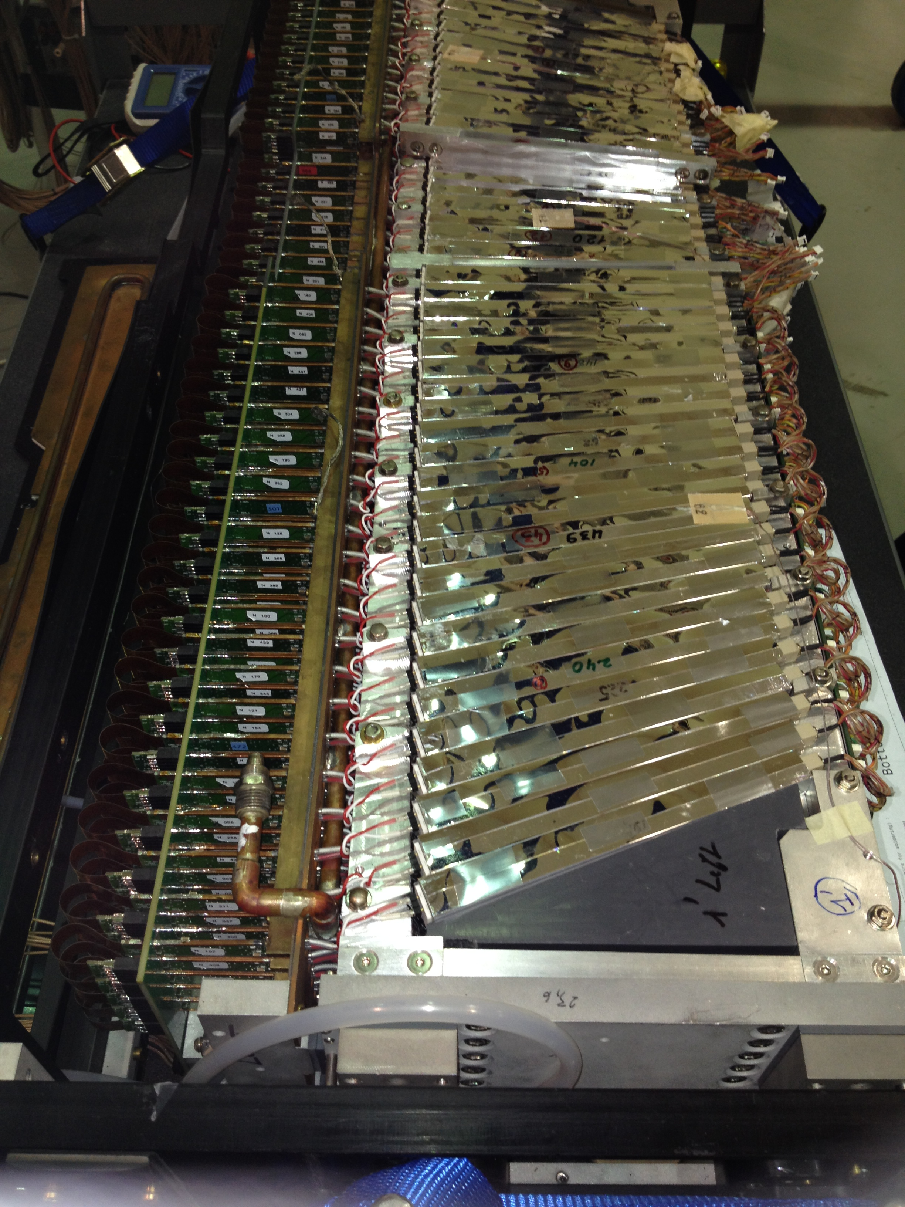
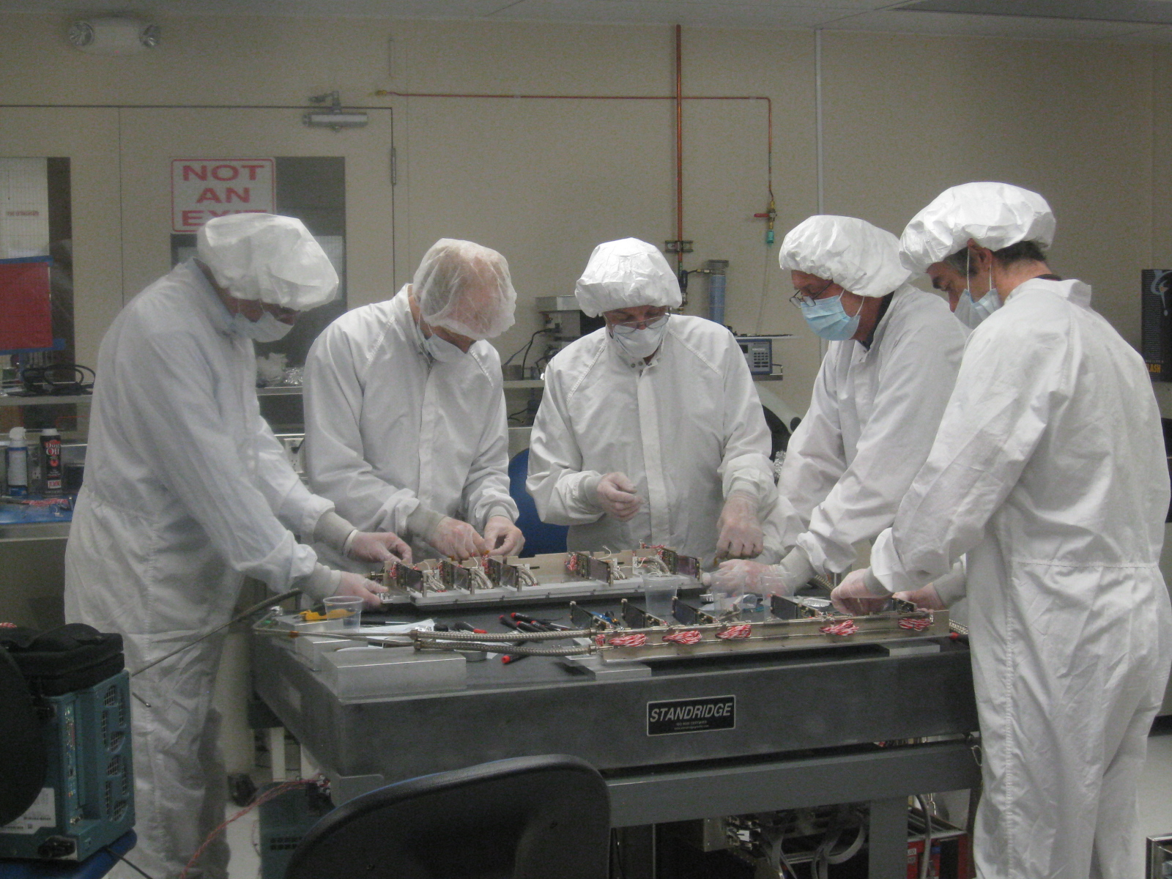
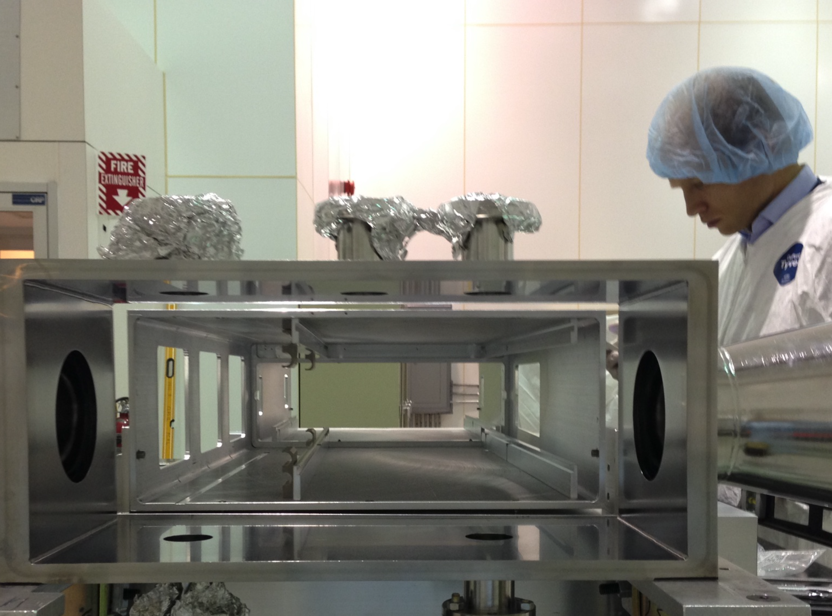
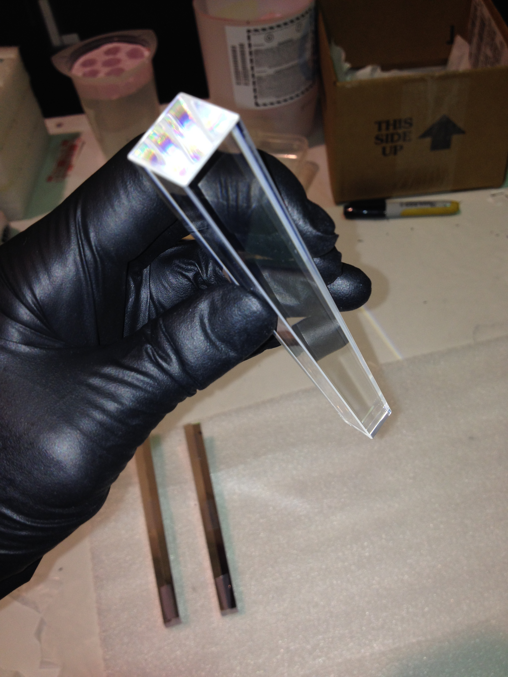
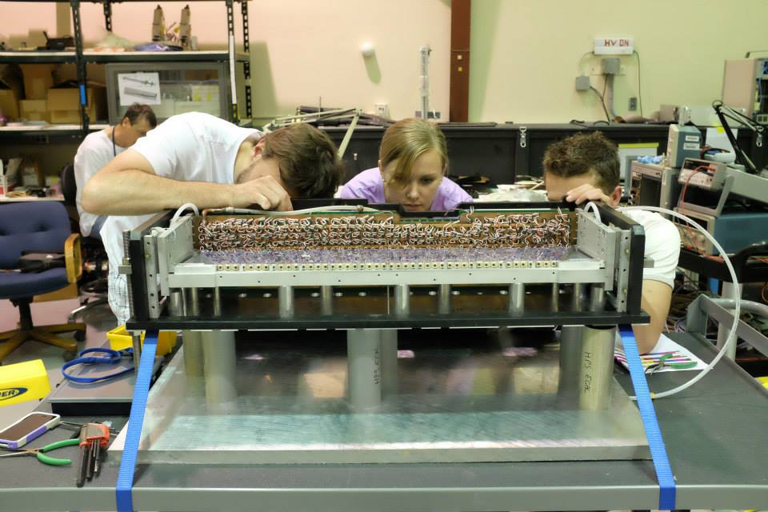
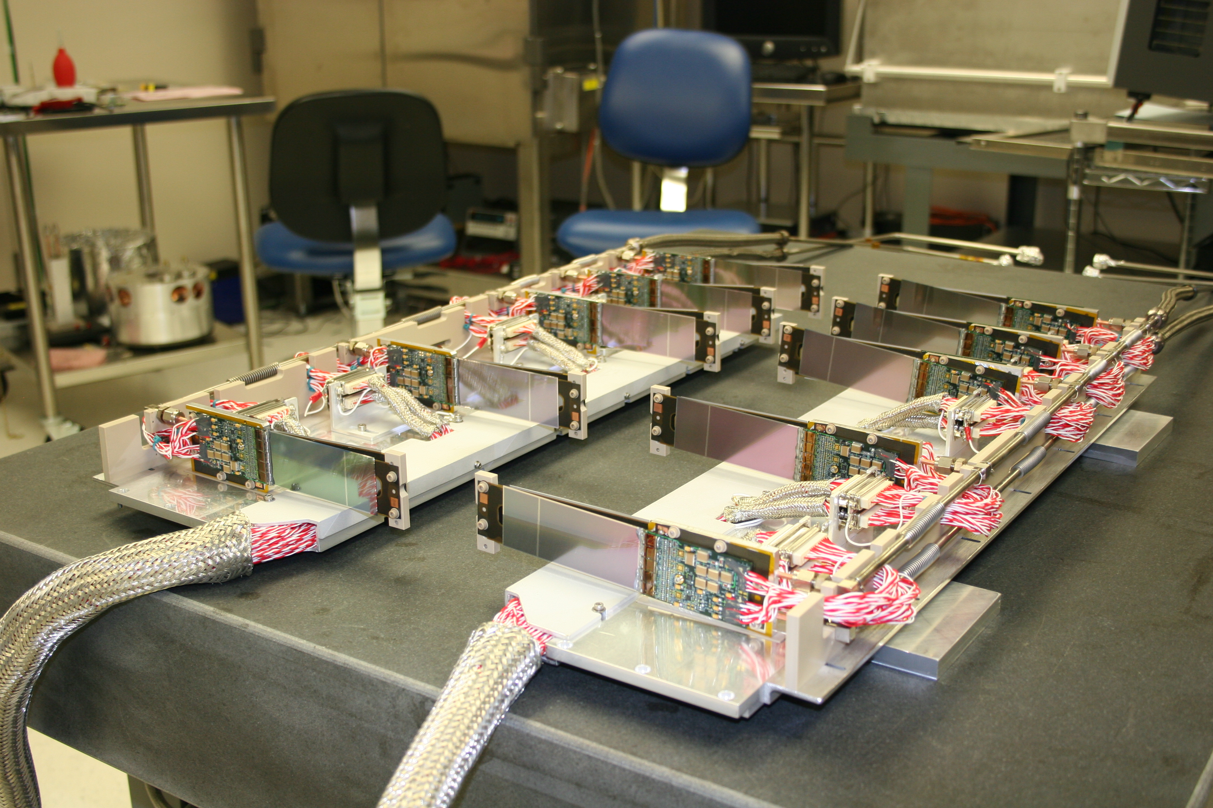
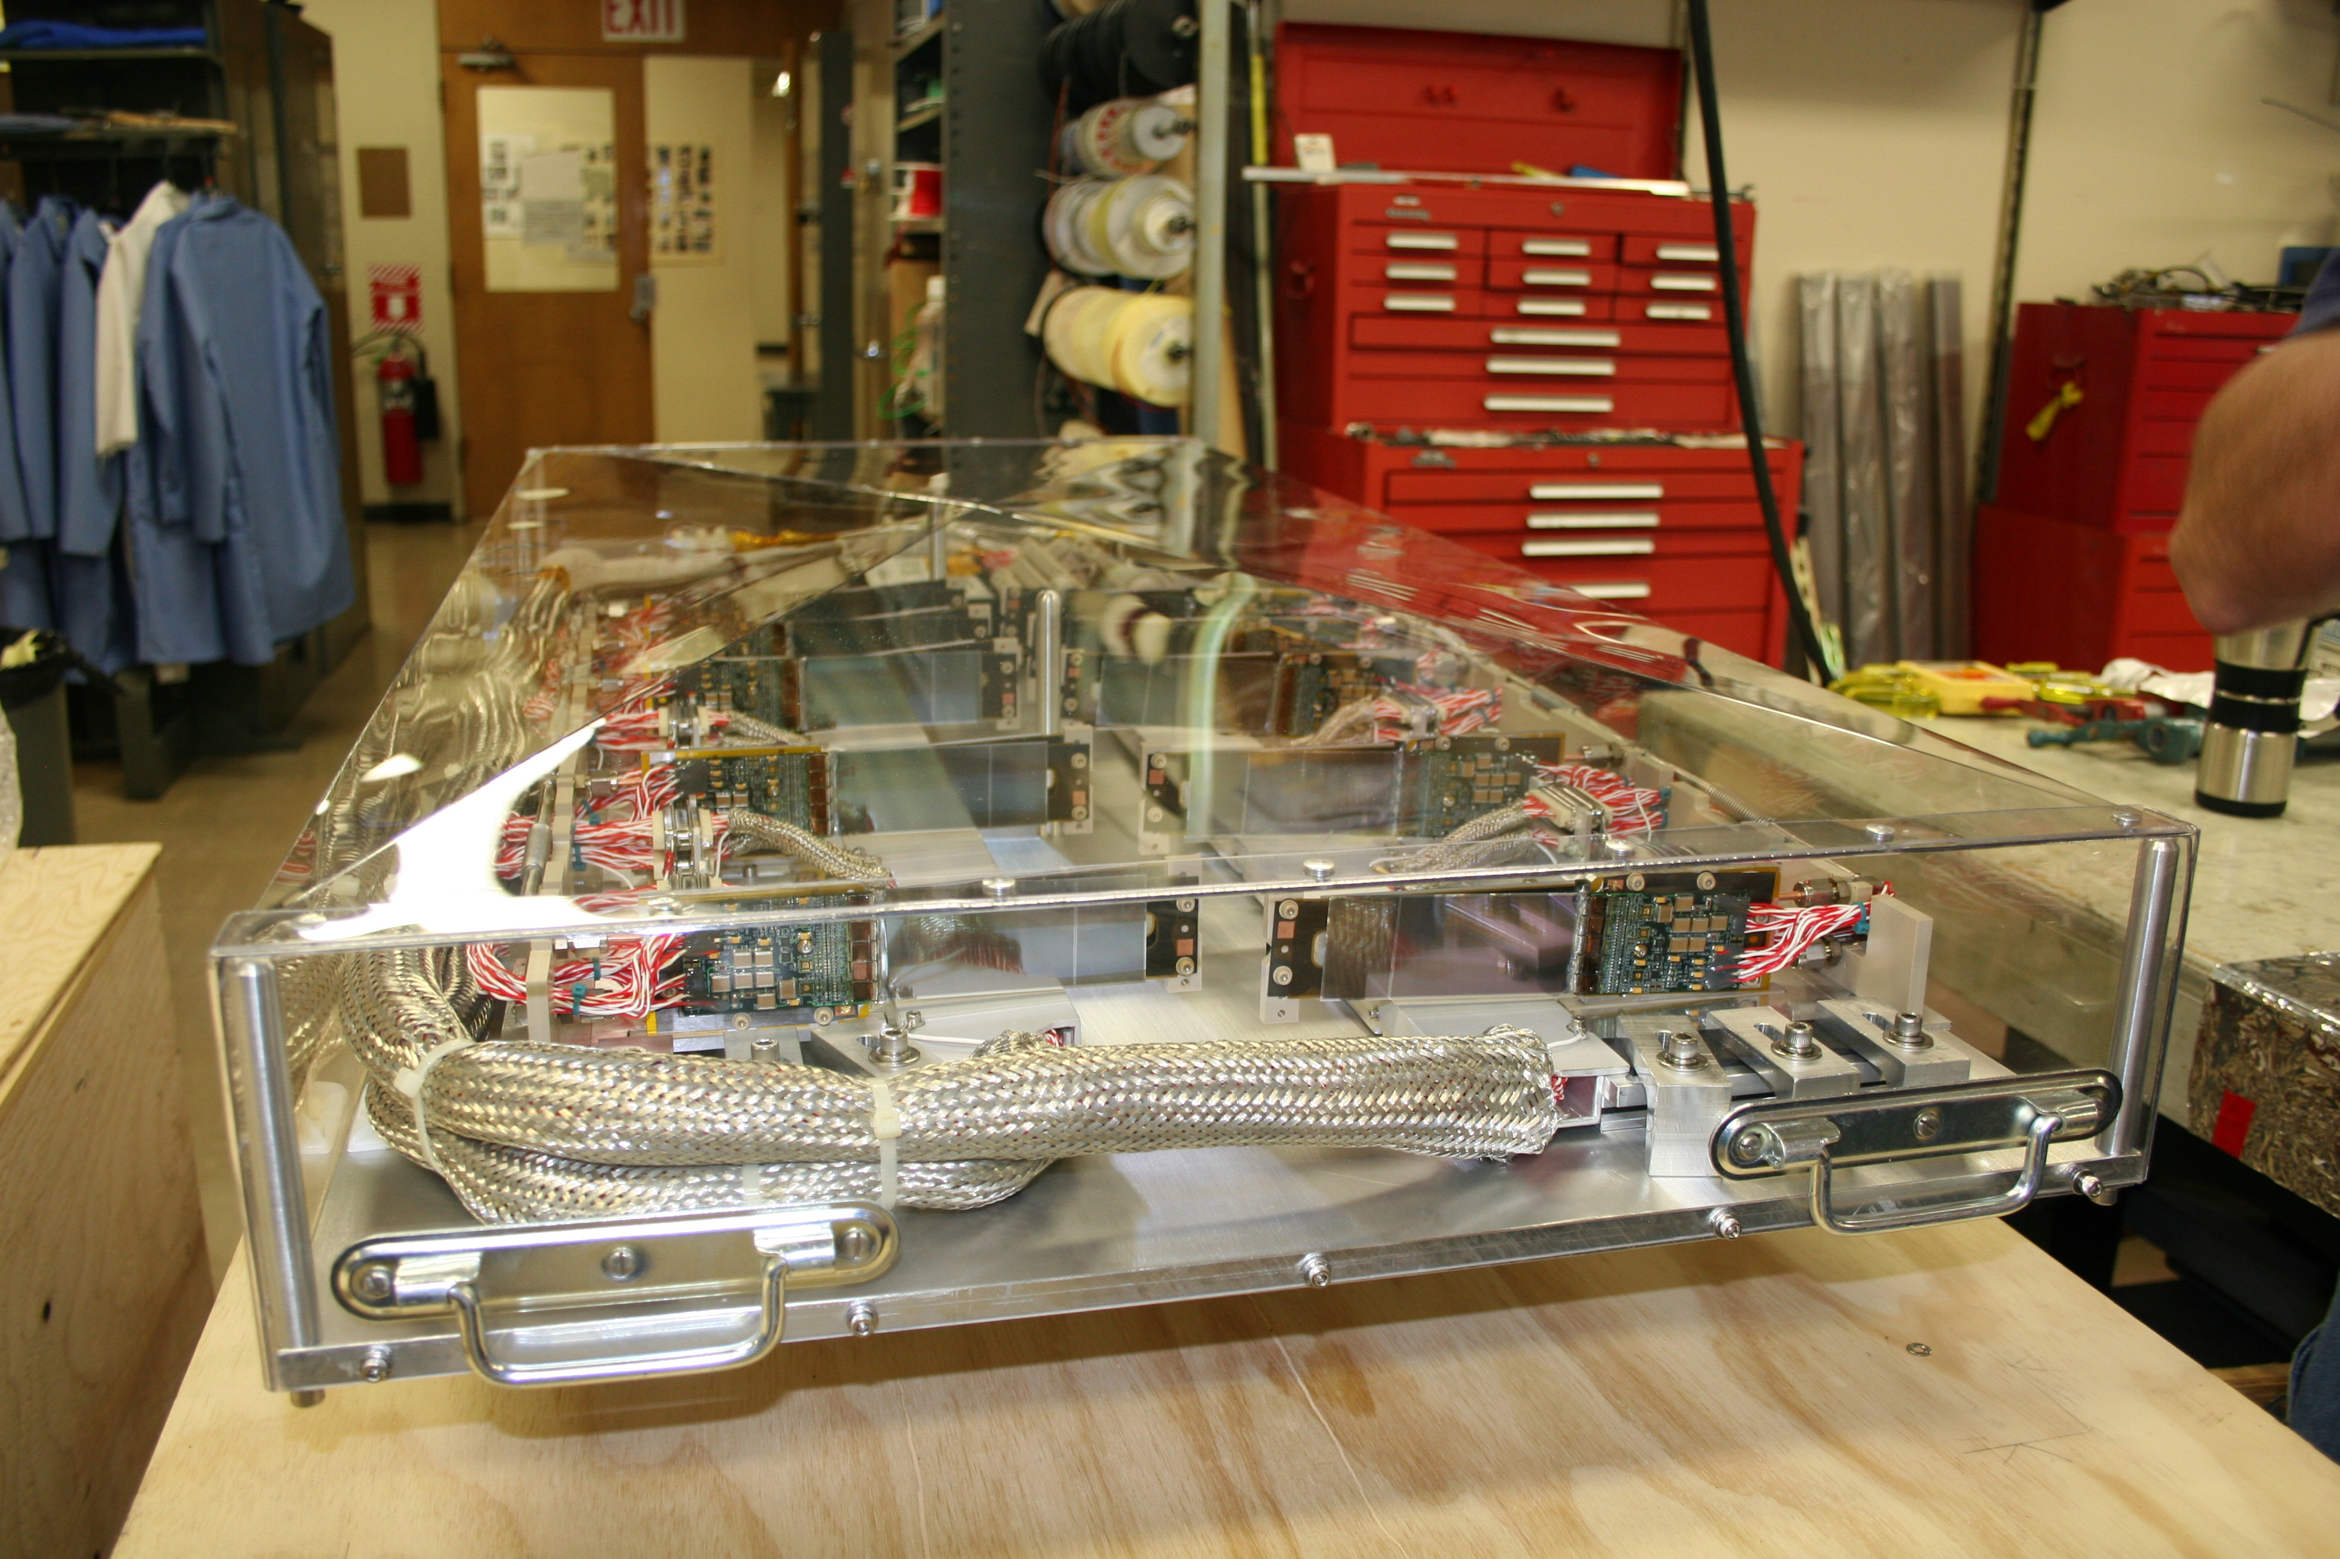
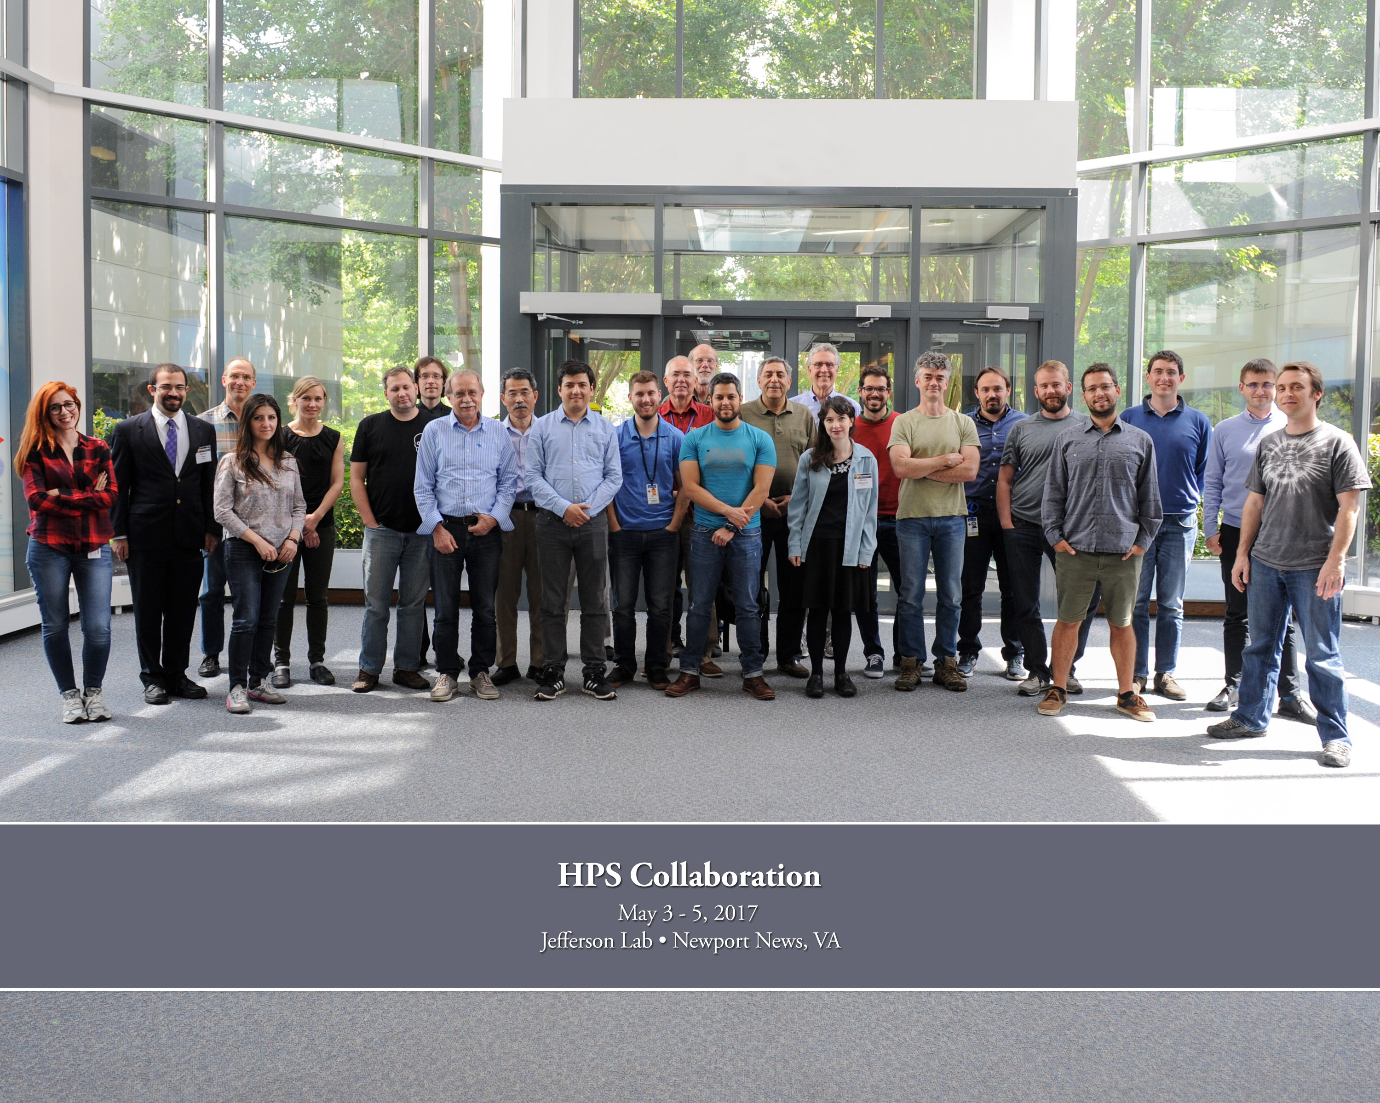
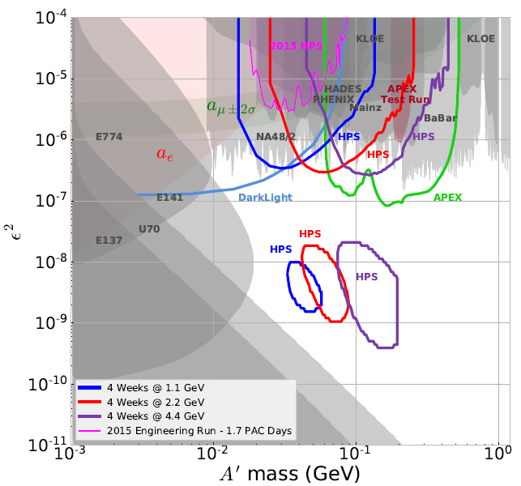
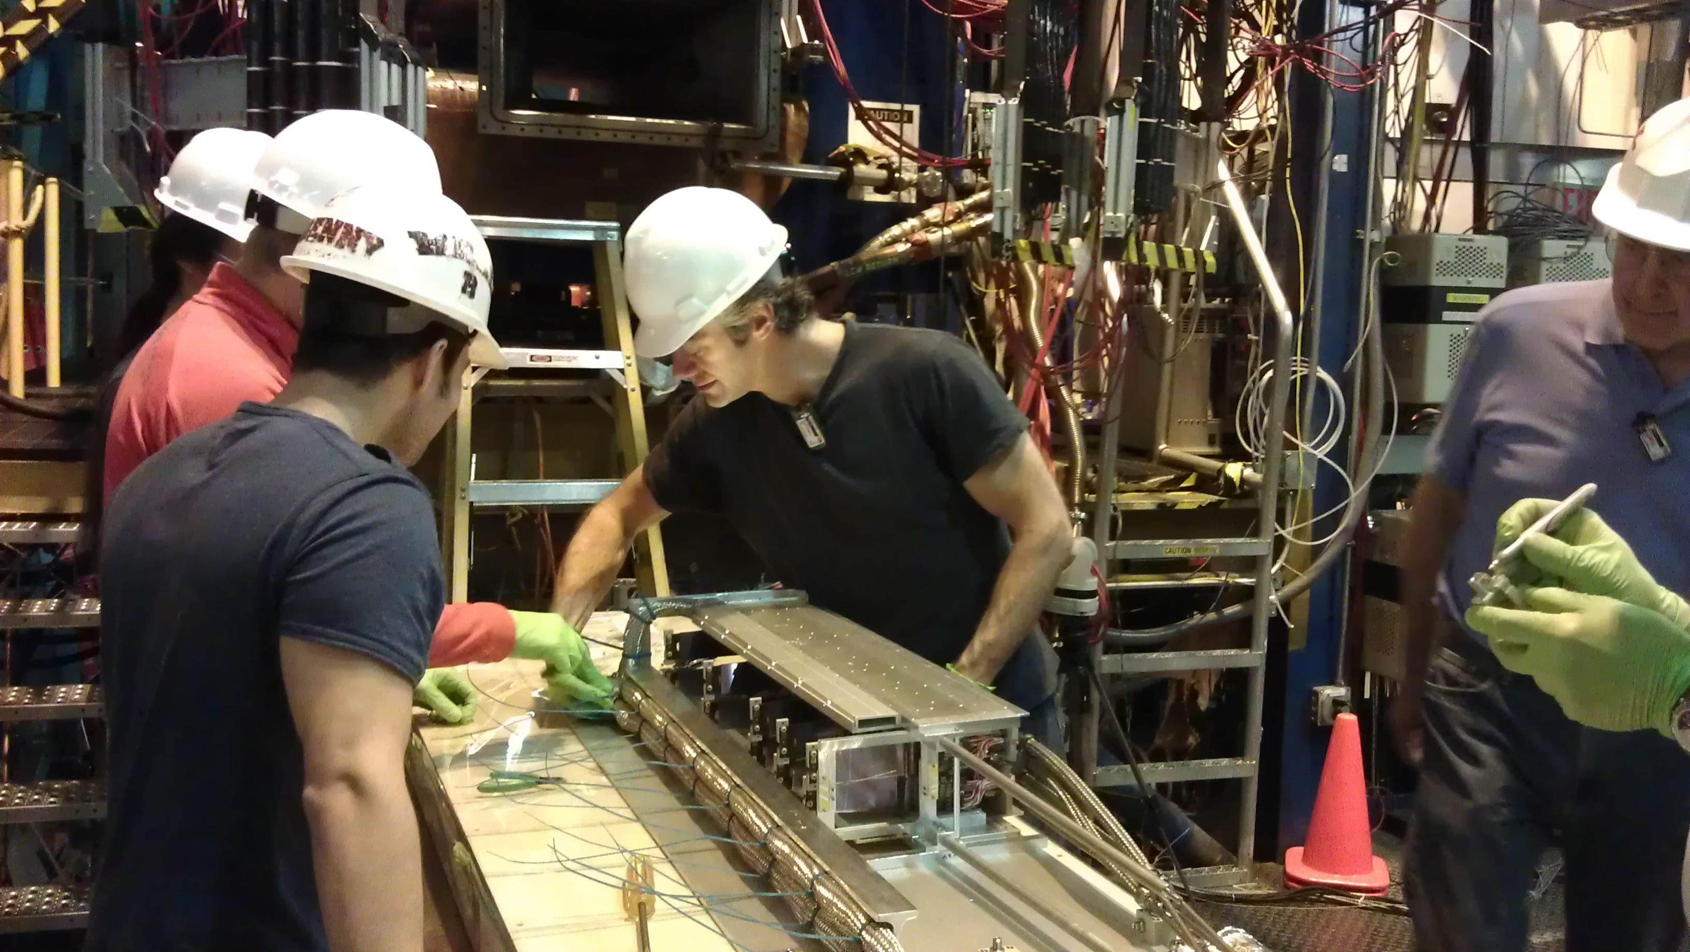
Heavy Photon Search
Thomas Jefferson National Accelerator Facility
What is it?
HPS In Action
The Heavy Photon Search detector is composed of a Silicon Vertex Tracker (SVT) and Electro-magnetic Calorimeter (ECAL) to determine:
1. Where the particles are generated
2. The energy and directions of the particles
When particles cross the detectors, they release a fraction of their energy. We call this process a “hit”. These hits are detected by 23040 charge sensitive Silicon strips in the SVT. Each element records the position of the cross and deposited energy. After transversing the silicon layers, the particles then deposit almost all their remaining energy in a few of the calorimeter’s 442 crystals.
Dedicated software used to process all the hit energies and positions and ”reconstruct” the properties of the particles like charge, momentum, directions and nuclear collision position.
The complete HPS system is installed behind and at the end of the Hall-B beamline, in a dangerous radiation area. A hypothetical heavy photon decaying into an electron positron pair is shown as a representation, but below is a real pair measured in 2015.
A representation of a single collision recorded in May 2015.
We collect about 18000 of these events every second.
You can see the 2 particles hitting the 6 layers of the SVT and both halves of the ECAL.
Left-bending tracks are positively charged particles, and right-bending tracks are negatively charged particles. In this event there is one electron (negatively charged) and one positiron (positively charged).
The SVT apparatus operates inside a vacuum chamber.
The 442 ECAL crystals used to measured the particle energy
Tech Specs
Part of the search for the heavy photon will consist of a pure bump hunt, like the one on the left. Can you see it?
Our detector’s resolution and reconstruction algorithms can be absolutely sure that any “bump” is either a real signal or a background/statistical fluctuation.
SVT
high-rate environment > 1 MHz / mm²
high-radiation environment
> 10¹⁴ 1-MeV neq./month
operation within 2 Tesla magnetic field
signal to noise ratio > 20
acceptance down to 15 mrad
300 um thick Silicon sensors
23040 channels readout clock is 42 MHz
Sensor temperature maintained at -10 °C, in vacuum with chamber motorized supports to remotely move sensors away from beamline for protection
0.5 mm between beam center and detector edge, 10 cm downstream from target
low material budget (0.7% X₀ per layer), momentum resolution of ~6%
ECAL
442 16 mm x 16 mm x 16 cm Lead Tungstate (PbWO₄) crystals
Light collection and amplification by 10 mm x 10 mm avalanche photodiodes
temperature controlled at 17±0.3 °C
acceptance down to 15 mrad
surrounding vacuum chamber to contain and avoid the “sheet of flame”
Energy resolution ~ 4%
Position resolution ~ 2 mm
Time resolution ~ 200 ps
Efficiency ~99%
Silicon Sensor and Readout Chip
Vertex Hunt for Heavy Photons. We can predict exactly the shape and tail of each Heavy Photon mass hypothesis so when we measure the actual vertex of origin we can check if the reaction produced a heavy photon.
Building and Installing the HPS detectors
Did you know?
The Silicon Vertex Tracker is built to operate in high magnetic field, (about 4 times stronger than what can erase credit cards, damage peacemakers, etc).
The SVT contains 23040 strips, each connected to an electronic channel. The strips have a width smaller than the diameter of a human hair.
The SLAC electronics design is capable of reading the 23040 SVT channels 42 millions times / second, each with 6 time samples. All at the same time!
The whole sensitive area of the tracker must be very light so it doesn’t slow down and scatter the particles. A full module, containing 1278 strips, weights less than one ounce.
Best in class: High radiation environments can severely degrade the performance and lifetime of silicon detectors. This SVT is the first to be located so close (0.5 mm) to a high luminosity electron beam.
ECAL assembly in action and closeup of one crystal.
Brain surgery? No, SVT construction. The building and assembling of the detector took place in a special clean room with HEPA filtering of dust particles to protect the modules.
SVT assembled and ready for installation.
The HPS collaboration met at JLab in March 2017
Contributing Institutions
Search for Heavy Photons in Hall-B at Jefferson Lab. The HPS (Heavy Photon Search) experiments will search for dark matter in uncharted territories, where no one has looked before. The graph shows the sensitivity of the HPS experiment to a heavy photon in terms of its mass and how strongly it interacts with normal matter.
Jefferson Lab, Newport News, VA, USA
Standord Linear Accelerator Center, CA, USA
Institut de Physique Nucléaire d'Orsay,
Orsay, France
SVT being installed in Hall B at Jefferson Lab
University of California, Santa Cruz, CA, USA
Old Dominion University, Norfolk, VA, USA
Istituto Nazionale di Fisica Nucleare,
Genova, Italy

